Slide 1


Galaxy formation and Evolution
We will discuss the basics of:
The Big Bang
Large scale structure formation
The first stars and galaxies
The present day Universe
Themiya Nanayakkara
@themiyan
With contributions from Prof. Rychard Bouwens,
Leiden Observatory

Slide 2
Pre Copernican Universe
Earth is at the centre of the eternal, unchanging Universe: based on Ptolemy’s Almagest 150 AD

Slide 3
There is nothing special about the location of Earth in the Universe
Work lead by Copernicus, Bruno, Galileo, Kepler
The Universe was still viewed as eternal and unchanging
Newtonian Universe

Slide 4
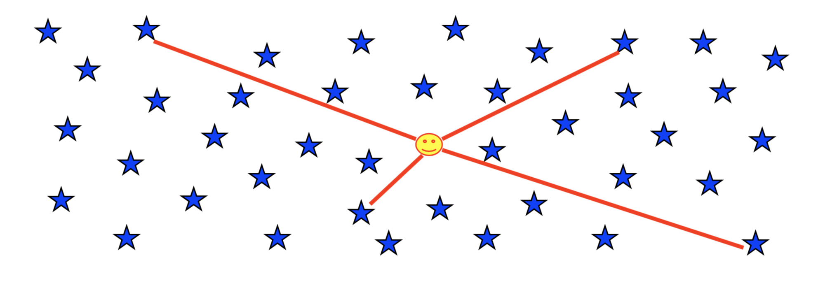
Olber’s Paradox
Why isn't the night sky uniformly bright?
In the 19th century, an astronomer named Heinrich Olbers stumbled on a contradiction that could not be easily explained: why doesn't the night sky look uniformly bright?
A sky that is uniformly bright would appear to glow, yet our night sky appears black with a scattering of stars, planets, and galaxies dotting the observable sky.

Slide 5
Olber’s Paradox
Dust attenuation
Edge to the stars
Universe/stars has a finite age
Contractions and expansions
The Universe has a finite age
Notes:
Butdustwillheatandreradiate
Edge to the stars : ViolatesCopernicanPrinciple
Finite age: Violates permanency
contractions/expansions: Nonoticeableeffectunlessextreme

Slide 6
Why is the Universe not permanent
Problems with:
Olber’s paradox
Conservation of Energy
Ages of Earth, meteorites, and stars.
Notes:
Energy conservation: for stars to shine indefinitely they would require
an infinite fuel reserve

Slide 7
Einstein’s Universe
In order to achieve a static Universe Einstein introduced a counter-balance to his GR models, the famous cosmological constant : agreed with Austrian physicist and philosopher E. Mach (1838-1916) regarding the genesis of the property of inertia.
According to Mach, the inertial mass of any body is due to the influence of the universe as a whole.

Slide 8
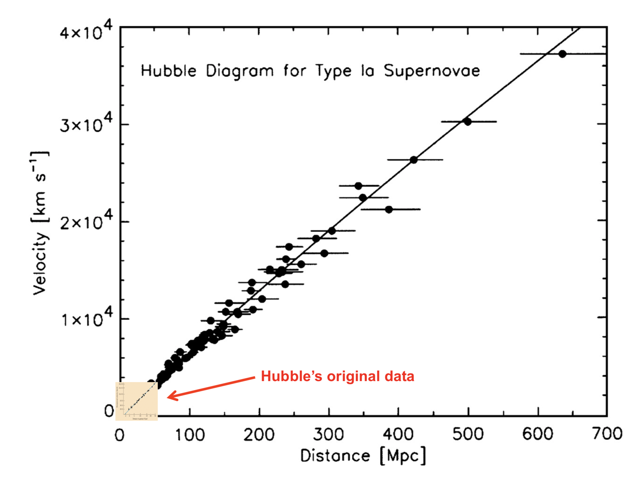
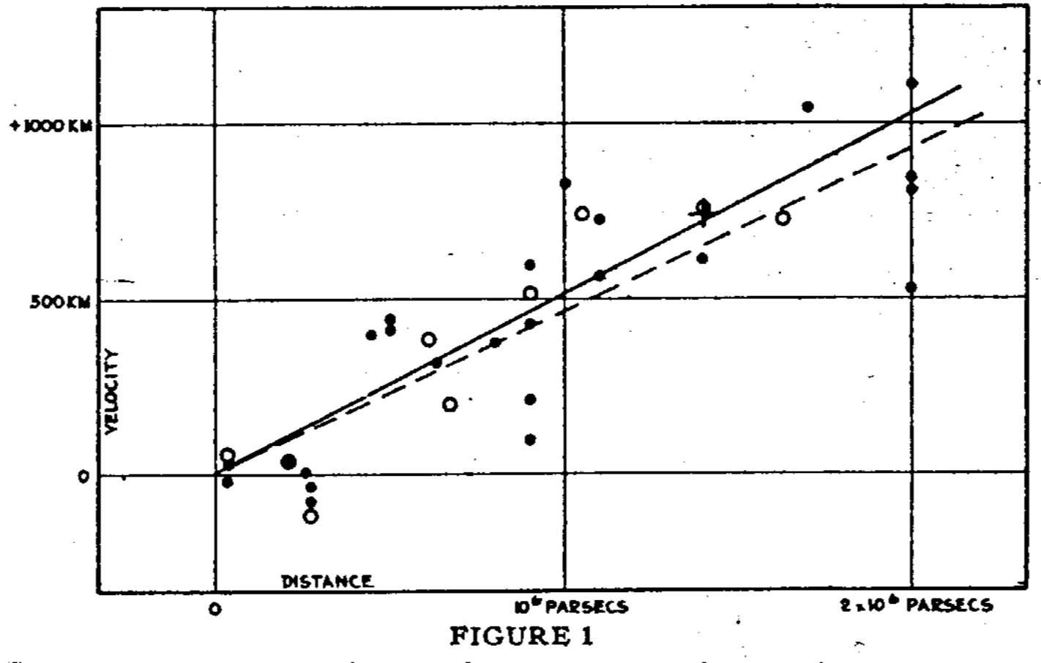
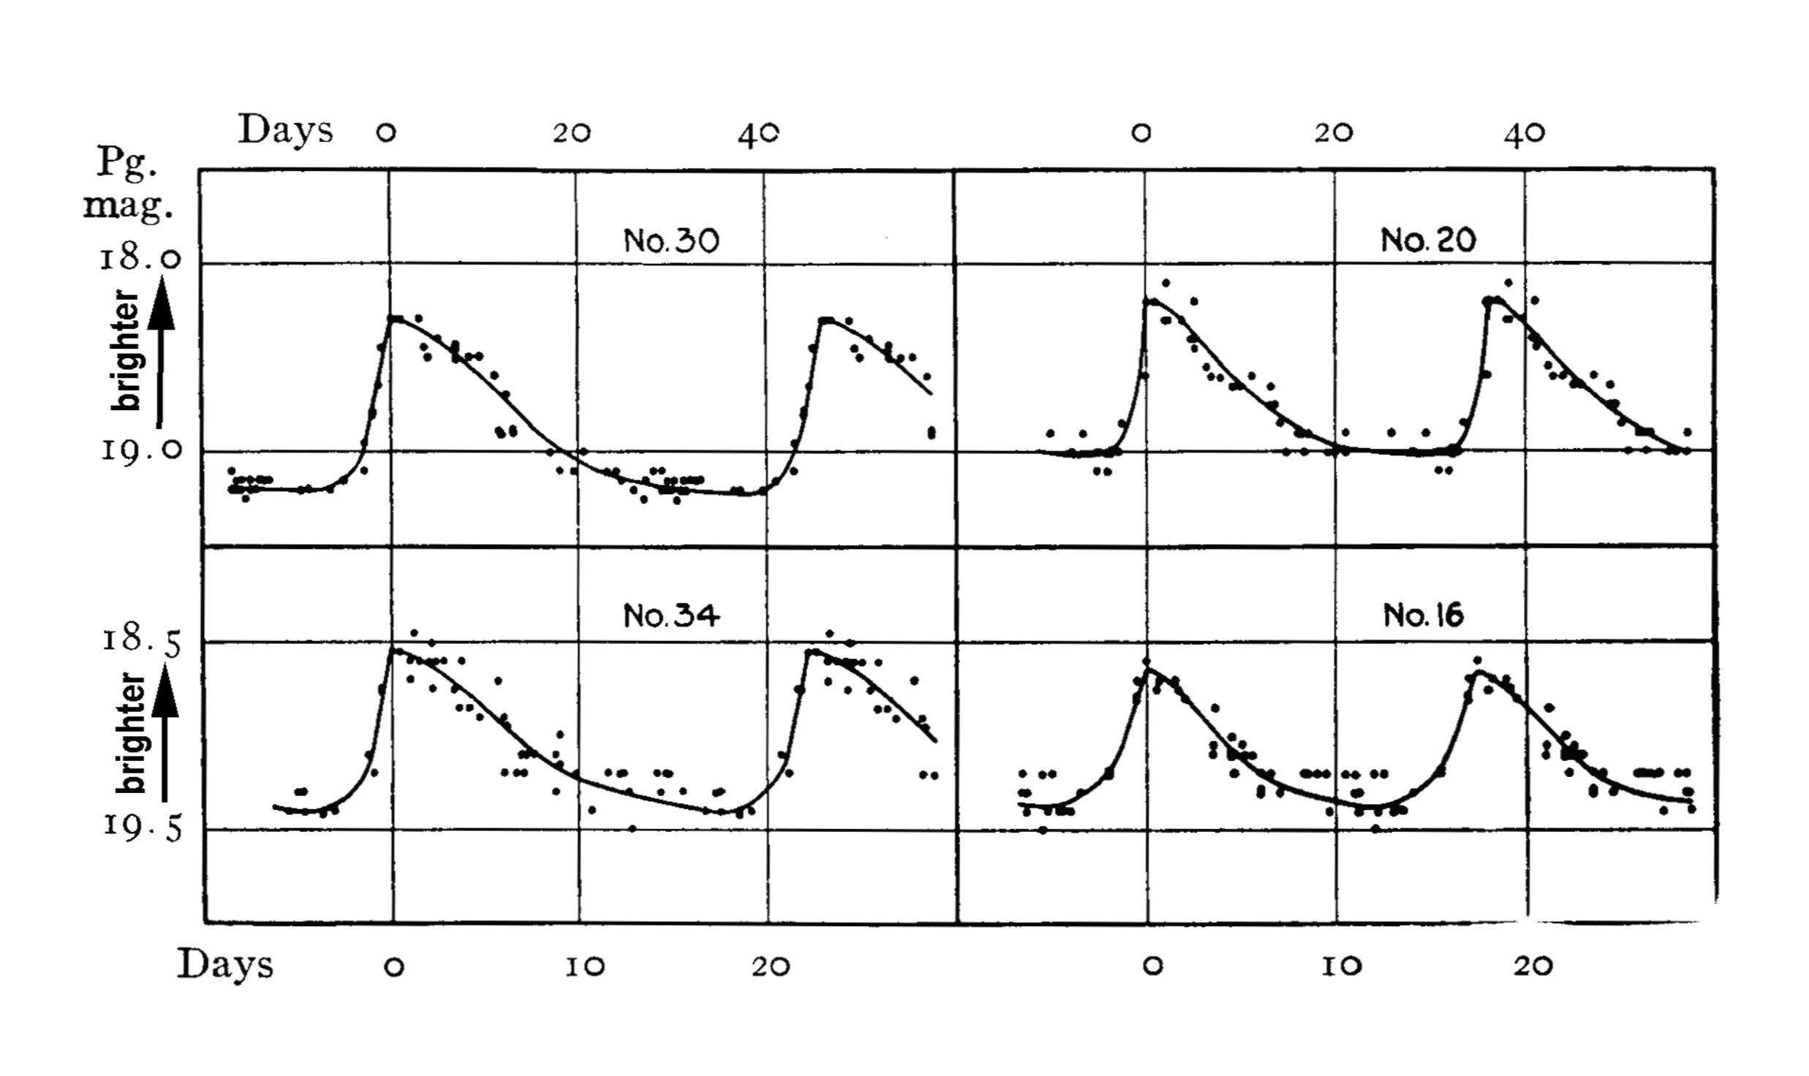
Hubble–Lemaître Law
Discovery of extra-galactic sources.
Comparison between redshift and Cepheid variables showed that galaxies were moving away from us: recession velocity is proportional to the distance.
Homologous expansion of the Universe: Shapes/patterns in the Universe not altered but are scaled isotropically.
Notes:
• ProvedthatM31wasexternaltoourgalaxy.
• Hubblecollectedmanygalaxyimagesandspectra
• MeasuredbrighteststarsandCepheidvariablestogetdistances
• Alsousedbrightestclustermember
• Measuredoffsetofcommonspectralfeaturestogetvelocity

Slide 9

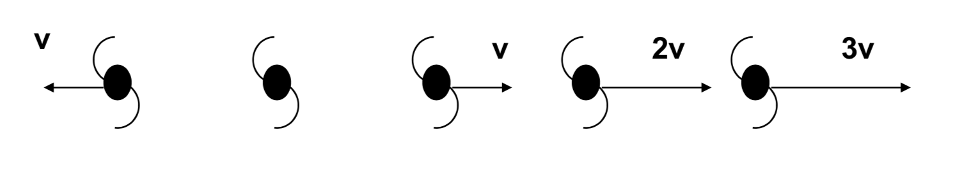
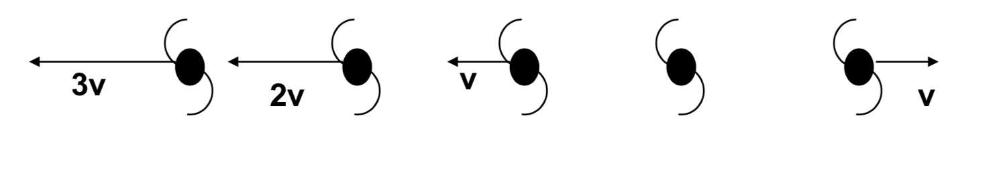
The universal expansion of the Universe
If we are not in a special place in the Universe why is most galaxies moving away from us?
Does not violate the Copernecian principle: if A sees B receding, then B sees that A is receding. The diagrams from the two different points of view are identical except for the names of the galaxies.

Slide 10
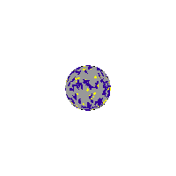
The universal expansion of the Universe

Slide 11
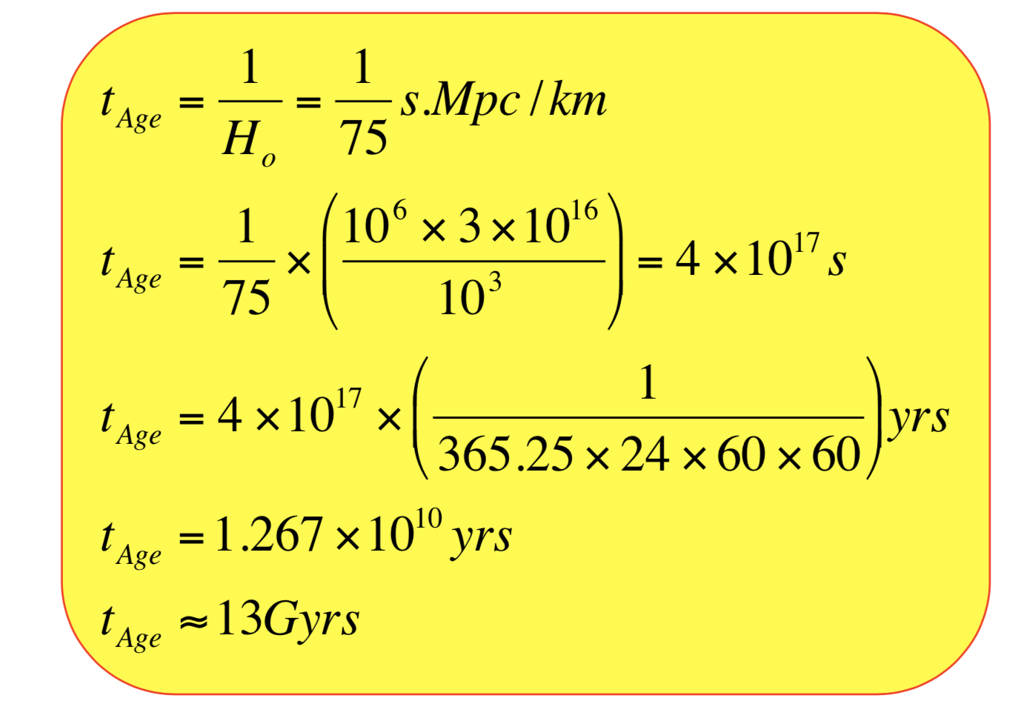
The age of the Universe

Slide 12
The Big Bang theory

Slide 13
The Big Bang theory
Developed by Alexander Friedmann and Willem de Sitter on Einstein’s general relativity models
General relativity - cosmological constant provided the basis for expansion
Solved a few problems know then:
Correctly predicts the abundances of light elements
Explains the CMB as relic of the hot initial phase
Naturally accounts for the expansion of the Universe
Provides a framework to understand the formation of cosmic structure

Slide 14
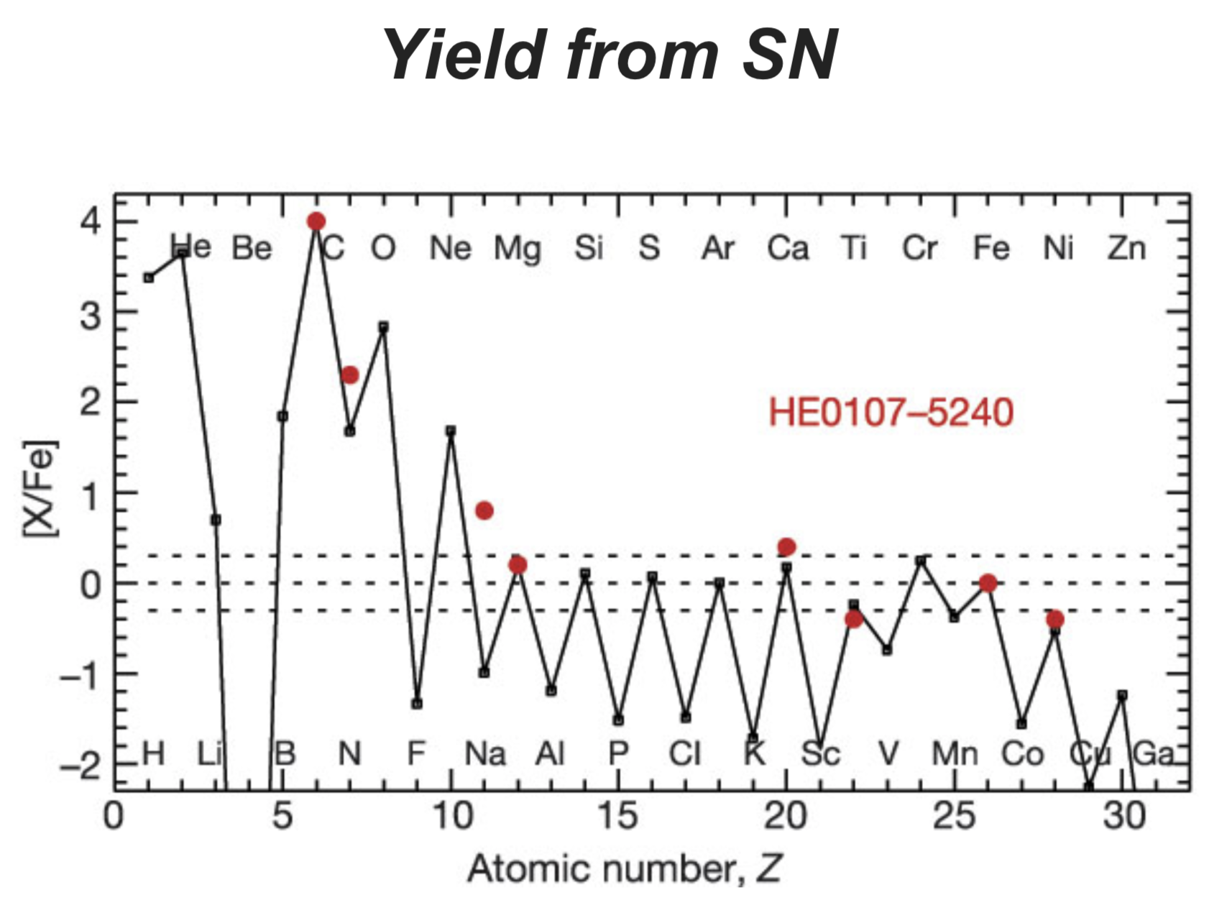
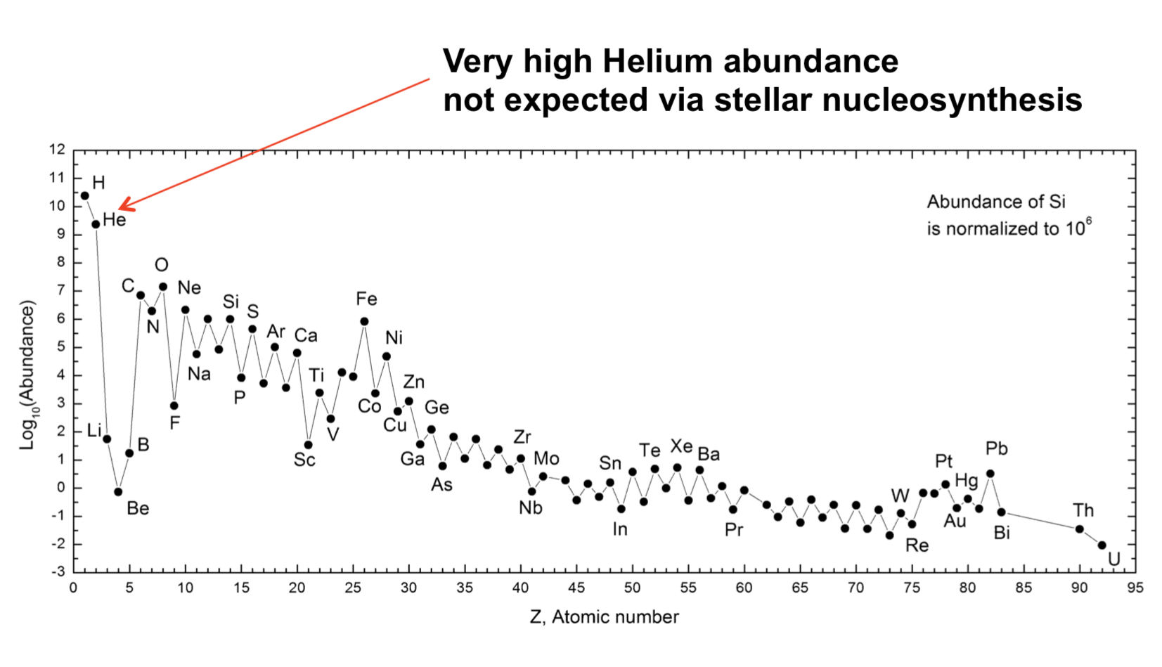
The He problem
Notes:
http://adsabs.harvard.edu/abs/1967QJRAS...8..313T

Slide 15
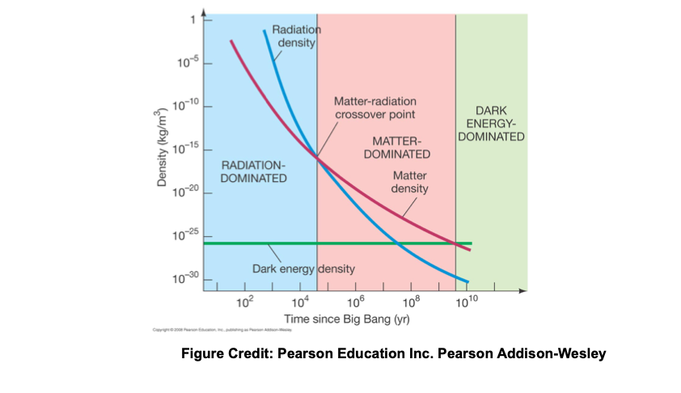
Early Universe was radiation dominated

Slide 16
Looking back in time
– Radiation-matter coupling (i.e., ionised to compton scattering)
– Nuclei split apart (D=2Mev, Fe=7 MeV) – Neutrons/protons —> Quarks (n=939.6MeV, p=938.3MeV)
– Quarks destroyed (~GeV+) – Pure energy bath (matter being formed and anhilated - abundant energy)
– Singularity, creation event (Big Bang)
t=0

Slide 17
Solution to the He problem
The high density in the early Universe made it possible for Deuterium to find a partner to produce He
p+n→²D, D+p→³He, D+D→⁴He
From big bang cosmology 25% of the baryonic mass is He
D abundance from QSO sight-lines is a measure of the baryon density of the universe —> 1H atom per 8m³

Slide 18
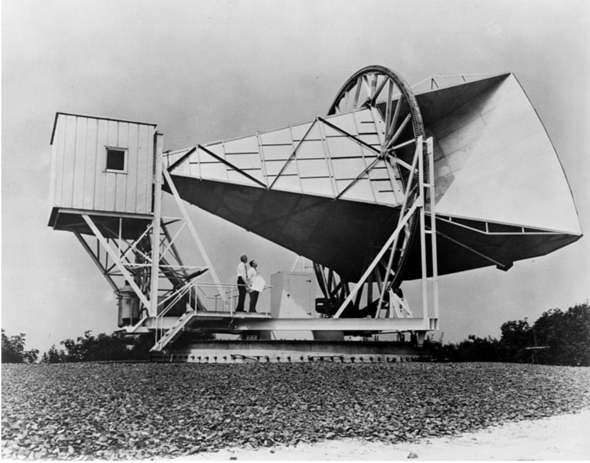
The Comic Microwave Background (CMB)
Predicted by George Gamov, 1948: a perfect black body spectrum should exist with T≈5K
Penzias and Wilson: Nobel Prize 1978
Notes:
UnliketheexpansiontheCMBwaspredictedbeforeitsdiscovery
BigBangmodeladoptedoverSteadyStatefollowingCMB
astheUniverseexpandsitcools

Slide 19
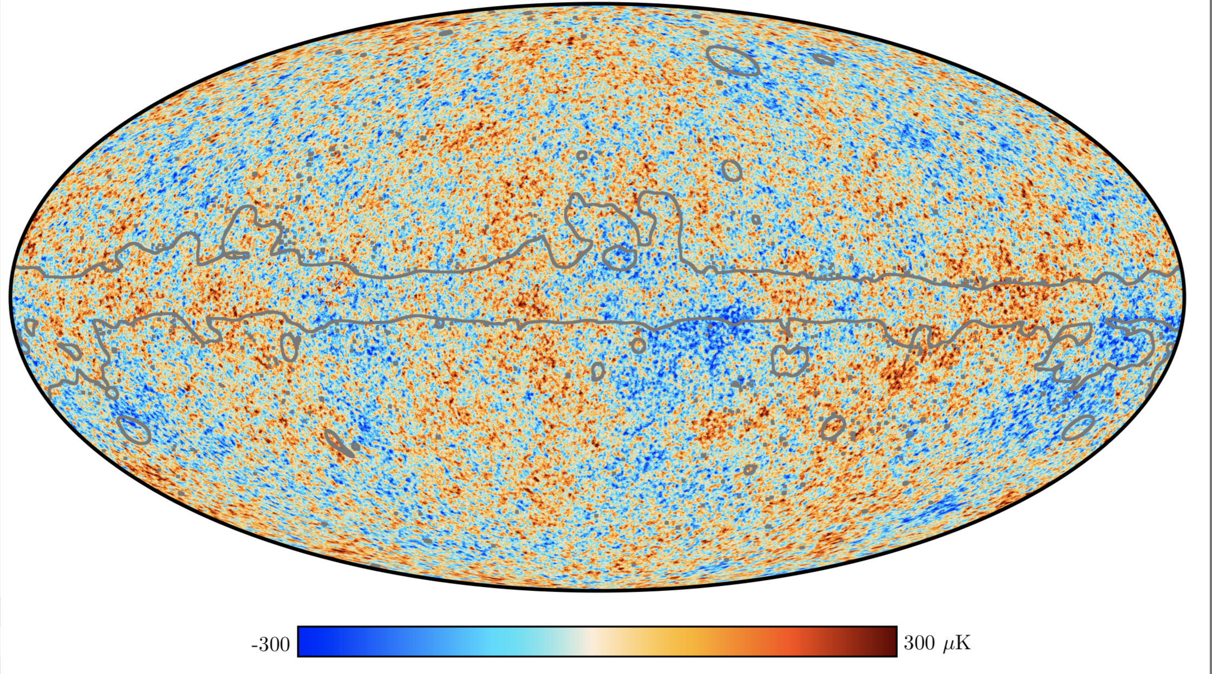
All Sky CMB Map

Slide 20
Problems with the Big Bang model
Origin of the Universe
The horizon problem
The flatness problem
Origin of the baryon asymmetry
Monopole problem
Origin of primordial density fluctuations
Nature of dark matter
Nature of dark energy
Notes:
Horizon problem—> 1 degree isotropies expected, observed all sky with CMB

Slide 21
The early Universe according to the Big Bang theory
Big Bang: singularity, energy appearing from nowhere
Inflation: the rapid exponential expansion phase of the Universe
Matter-antimatter annihilation: symmetry broken, high photon-to-baryon ratio
The quark soup: All possible particles co-exist bubbling in and out of existence.
Baryogeneis: neutrons and protons made
Nucleosynthesis: plasma of charged nuclei (75%H, 25%He) + electrons
Recombination: Neutral atoms, matter and radiation decouple, the surface of last scattering
Re-ionisation and Galaxy formation

Slide 23
The first stars
Recombination: Misleading term meaning the combining of electrons + protons to form neutral hydrogen (z=1100, t= 378, 000 yr)
The first stars are expected to form around dark matter filaments
Almost no metals existed: so these stars are metal free and very hot!
Short life time and quick supernovae explosions resulting in the enrichment of metals in the Universe.

Slide 24
Video removed due to github file size restrictions
This can be downloaded from here: https://www.astro.ex.ac.uk/people/mbate/Cluster/cluster500RT.html

Slide 25
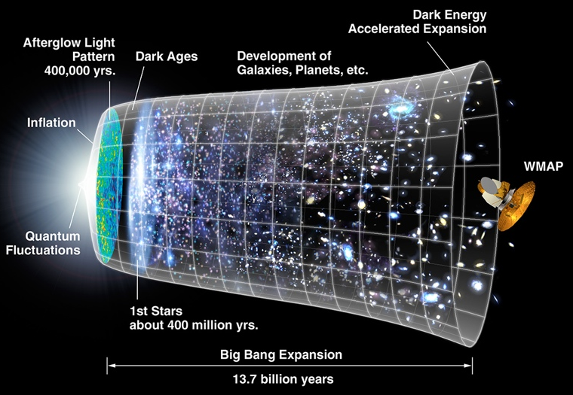
Where Do The Earliest Galaxies Fit into the Timeline of the Universe?
First
Stars
First
Galaxies
Normal
Galaxies
Now
Synthesis
of Elements
Recombination
BIG BANG
10⁻¹⁴
0.0003
0.2
0.4 0.7
1 2 3 13.7
Age of Universe
Billions of Years (Gyr)

Slide 26
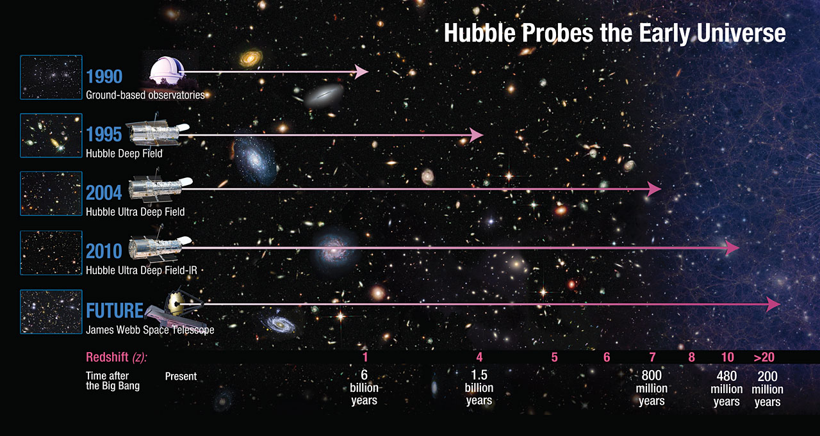
Hubble is now observing galaxies 97% of the way back to the Big Bang, during the first 500 million years (redshift z > 9.5)
reionization
Notes:
Read TITLE
into the epoch of reionization
Much of this progress is due to the Hubble Deep Field initiatives over the years, pushing to higher and higher redshifts.

Slide 27
Pauze

